Slide 1
Privacy and Cyberspace II
Cole Goodyear
Lindsay Grant
Samir Habbal
Steven Hatch
Katie Hayes
Eric Hemingway
Adam Hensley

Slide 2
Topics of Privacy and Cyberspace
Government Google Subpoena
Data Mining and Privacy
PETs
Privacy Legislation
Public Webcams
Computers in your Cars

Slide 3
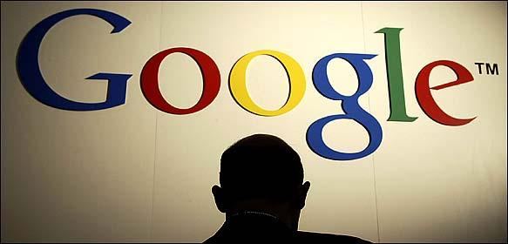
Government Google Subpoena

Slide 4

United States Department of Justice
In 2006 - Requsted records for millions of searches
  Strenghten argument for online pornography laws
  Broad data on search habits
    Not personal information
  Concern with where the
Government will go next
  Microsoft, MSN, Yahoo, AOL, and Google Subpoenaed
Another case
  Used Patriot Act to Request library users internet use

Slide 5
User Information Privacy
Concern over what personal information the Government will ask for next
The real purpose was to uphold the Child Online Protection Act (COPA)
  Material harmful to minors prevented from accessing
  Restricts protected free speech
  Courts have blocked the law from taking effect

Slide 6
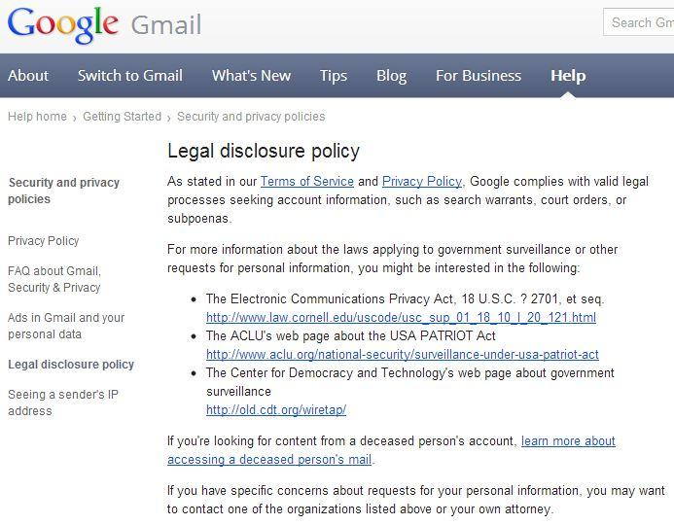

Slide 7
MSN, Yahoo, AOL
  Complied with subpoena
  Did not violate the privacy of users
Google
  Privacy of users
  Protection of trade secrets
  Goverment's attitude is that it is entitled to this information without justification
Electronic Fronteir Foundation
  Civil Liberties Group
"All the search engines have created a honey pot of information about people and what they search for. It's a window into their personalities - what they want, what they dream about. This information gets stored, and that becomes very tempting." - Kurt Opsah, Staff Attorney for EFF

Slide 8
What Do They Know About You?
At a basic level
  Record web sites users visit and search terms
  Cookies help keep track of a customers habits
  Google's cookie lasts until 2036
Email services
  Retain Personal Information users are required to enter

Slide 9
Be Anonymous
Services that protect your privacy
  Tor and Anonymizer
    hides a user's IP address from search engines by routing search requests through a maze of servers
    Tor is free
      Sponsored by the Electronic Frontier Foundation
    Anonymizer
      Pricier option
    Can result in slower web browsing
  Incognito Mode

Slide 10
Summing it up
Concerns that Justice Dept.
  Request is for a large body of data
    Rather than specific individual
  Privacy advocates worry personal data is part of the search
EFF
  Has urged search engines to limit the amount of information they gather
  Have listened, but there is a lot of resistance

Slide 11
PETs
What are they?

Slide 12

Privacy Enhanced Technologies
Main Goal
Give the user the ability to govern who gets their personal data and to what extent
4 Categories
Encryption Tools
Policy Tools
Filtering Tools
Anonymity Tools

Slide 13
Encryption Tools
Examples
Secure Socket Layer (SSL)
Transport Layer Security (TLS)
Pretty Good Privacy (PGP)
How it works
The communicating computers both have the a key used to encrypt and decrypt the data
One computer encrypts the data using the key
Sends the encrypted data to the other computer
The other computer decrypts the data using the key

Slide 14
Policy Tools
Examples
Platform for Privacy Preferences (P3P)
TRUSTe
BBBonline
How it works
An organization determines the rules on how a user's data should be handled and police the enforcement
Individual companies choose whether to implement these rules into their products
If the rules are implemented correctly the company is then accredited

Slide 15
Filtering Tools
Examples
SPAM soap
iHate Spam
MailWasher
Norton
McAfee
AVG
Clam
Window Security Essentials

Slide 16
Anonymity Tools
3 Types
Autonomy Enhancing
Seclusion Enhancing
Property Managing
Examples
Anonymizer
Freedom by Zero Knowledge
iPrivacy
Incognito SafeZone
.Net Passport

Slide 17
Anonymity Tools
Basic concept of the 3 types
Autonomy Enhancing - Software acts as the clean up crew as the consumer goes about his/her daily business
Seclusion Enhancing - Software acts as an intermediary that holds a limited amount of the consumers data so the merchant doesn't have too.
Property Managing - Software acts as a lawyer handling all communication between the consumer and merchant

Slide 18
Privacy Legislation
Lindsay Grant

Slide 19

Privacy
"The state or condition of being free from being observed or disturbed by other people."

Slide 20
Opinions on Technological Privacy
"Privacy is dead - get over it." -Steve Rambam
  Private investigator specializing in Internet privacy cases
"Privacy protects us from abuses by those in power, even if we're doing nothing wrong at the time of surveillance." -Bruce Schnier
  Internet security expert, author of The Value of Privacy

Slide 21
Electronic Privacy Breaches
Sony CD Spyware '05
The Craigslist Experiment '06
AOL Search Leak '06
Google Street View '07
Hotmail Hot Mess '09
Webcamgate '10
Facebook Apps '10
HealthNet Patient Data '11
iPhone Tacking '11
PlayStation Network Hacked '11
Carrier IQ '11

Slide 22
Privacy Act of 1974
Outline:
  To restrict disclosure of personally identifiable records maintained by agencies
  To grant individuals increased rights of access to agency records maintained on them
  To grant individuals the right to seek amendment of agency records maintained on themselves upon a showing that the records are not accurate, relevant, timely, or complete
  To establish a code of "fair information practices" which requires agencies to comply with statutory norms for collection, maintenance, and dissemination of records
Amended by the Computer Matching and Privacy act of 1988

Slide 23
Electronic Communications Privacy Act
What constitutes as electronic communications?
  Any transfer of signs, signals, writing, images, sounds, data, or intelligence of any nature transmitted in whole or in part by a wire, radio, electromagnetic, photoelectronic or photoopical system that affects interstate or foreign commerce, but does not include:
    Any wire or oral communication
    Any communication made through a tone-only paging device
    Any communication from a tracking device
    Electronic funds transfer information stored by a financial institution in a communications system used for the electronic storage and transfer of funds

Slide 24
ECPA Cont
Title I protects
  Wire communication in transit
  Oral communication in transit
  Electronic communication in transit
Title II protects
  Communication held in electronic storage
Title III protects against
  Prohibits use of pen register and/or tap or trace devices to record dialing, routing, addressing, and signalling information without a court order

Slide 25
Criticism of Twentieth Century Privacy Acts
New York Times ran an article in 2011,"1986 Privacy Law is Outrun by the Web"
  "Last year, for example, the Justice Department argued in court that cellphone users had given up the expectation of privacy about their location by voluntarily giving that information to carries. In April, it argued in a federal court in Colorado that it ought to have access to some e-mails without a search warrant. And federal law enforcement officials, citing technology advances, plan to ask for new regulations that would smooth their ability to perform legal wiretaps of various Internet communications."
  Article found here.

Slide 26
State Laws
Privacy Policies for Websites
    California, Connecticut, Nebraska, Pennsylvania
Monitoring Employee Emails/Internet Access
    Connecticut, Delaware, Texas, Colorado
Privacy of Personal Information held by ISP
    Minnesota, Nevada, California, Utah
Privacy: Online Activity
    California
      Using public libraries' online resources
      Protects against online book sellers releasing private information

Slide 27
For more information...
Visit epic.org (EPIC = Electronic Privacy Information Center)
Information on privacy and
  Cloud Computing
  Facebook
  Legislation
  Search Engines
  Google Street View
  Student privacy
  Etc.

Slide 28
Public Webcams
Katie Hayes

Slide 29
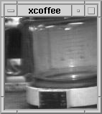
Very First Webcam:
First webcam was introduced
in 1991 from students at
Cambridge University.
It was called a "coffee-cam"
In 1993 it was connected to the internet for everyone to see.
It ran non-stop until it shut off in 2001, ten years later!
Public webcams can be placed in any public area and are available for the public to view.

Slide 30
Privacy and Security Issues:
Programs can be written by computer hackers that allow control of the webcam.
Webcams placed on streets by areas where people have a daily route can be used by predators to stalk them.
The government thinks terrorists may be monitoring webcams.
Webcams at government locations may allow people to see security measures, guard shift changes, and traffic patterns (vehicle and pedestrian).

Slide 31
Privacy issues:
People don't think it's right to have their pictures taken and kept without their knowledge.
However, webcams are usually placed too far away for people to be identified.
In Delaware there was a dispute between a guy who put up a camera overlooking a ferry terminal. The ferry company asked to have it taken down or they would start a lawsuit.

Slide 32
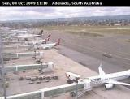
Airport Incident:
A live webcam in an Alaskan airport allowed users to control zooming and focusing the camera.
It was thought that terrorists could be using this to spot specific targets.
The airport officials said that these cameras only offer three views, two including runways, and are fairly unharmful in a
security sense.

Slide 33
Interesting Uses of Public Webcams
One study was done at a DMV that used the webcams to observe people's naturalistic behaviours.
Public webcams are put in environments to ensure the safety of humans and to monitor the animal population.
Scientists use webcams to see the effect of climate on plants.
Paolo Cirio takes images from public webcams and where he sees people standing in a certain spot he creates life-sized prints and puts them on the wall.

Slide 34
Computers In Cars
Cole Goodyear and Samir Habbal

Slide 35
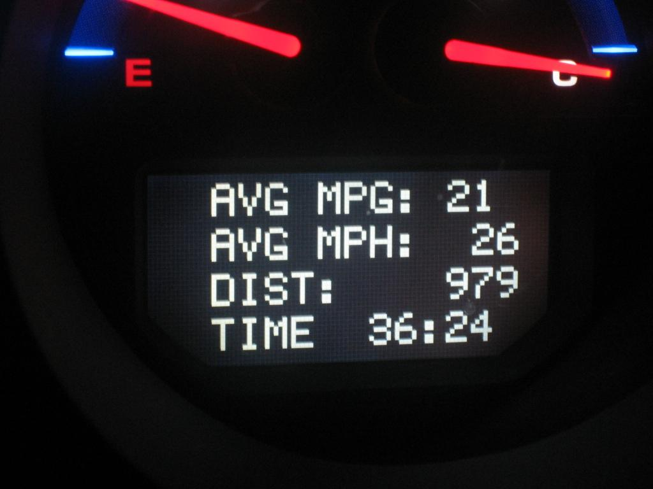
Computers In Your Car
The first mechanical trip computers were introduced in the 1950's
Initially used as an accessory to enable the driver to maintain a given time schedule
Modern day trip computers display average mileage, average speed, distance traveled..
Some trip computers display diagnostic codes mechanics use

Slide 36
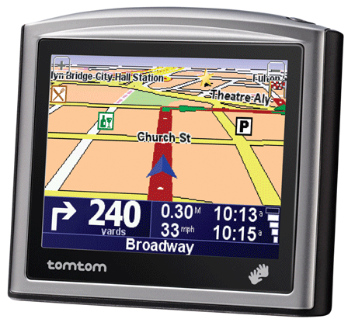
Automotive Navigation Systems
Satellite navigation system designed for automobiles
Uses GPS to acquire position data to locate
Makes use of road map database to give directions
Dead reckoning using distance data from sensors attached to the drivetrain
Signal loss can occur in tunnels or urban canyons

Slide 37
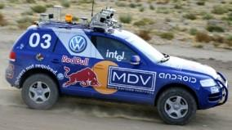
Google Self-Driving Car
A project that involves developing technology for driverless cars
  Sebastian Thurn, Stanford University
    Co-invented Google Street View
The first driverless car developed "Stanley"
  Won $2 million from the US Department of Defense
  Currently located at the Smithsonian
Currently 15 engineers
working on developing
the technology further

Slide 38
Google Self-Driving Car
The system combines information gathered by Street View with artificial intelligence
  Input from video cameras, a LIDAR sensor on top of the vehicle, radar sensors on the front and back, and a position sensor on the rear wheels help orientate the vehicle
There is a test fleet of about a dozen vehicles traversing roads in California and Nevada
The fleet has driven in excess of 300k miles and not logged a single accident

Slide 39
Google Self-Driving Car
The cars are allowed to drive anywhere in CA or NV so long as there is a driver in the front seat that can take over in case of system failure
  The "drivers" have unblemished records and are yet to have to step in to take control of a vehicle
They have successfully traversed Lombard Street in San Francisco
The only documented accident was when one of the vehicles got rear-ended at a red light

Slide 40
Google Self Driving Car
There are no immediate plans for the cars to become commercially available although that is the plan for the future
Forbes says that by 2040 we won't need drivers licenses and we'll be much safer on the roads
Google's innovations are going to pave the road for safer streets in the future

Slide 41
Computer in your car, Where are they?
Computers are located everywhere in your car. For example, your radio is controlled by a computer, your dashboard etc...
They are in charge of monitoring engine emissions and adjusting engine to keep the emissions as low as possible.
Computers are necessary and important to your car
All car manufactured today contain at least 1 computer.

Slide 42
How do they work?
Computers receives information from sensors
Using those sensor, they then can control things like the fuel injector.
Computers senses if something had gone wrong and then they inform the driver by putting a light on the dashboard.

Slide 43
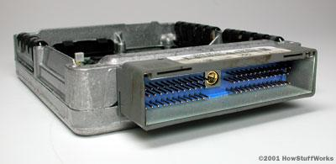
ECU (Engine Control Unit)
The most powerful computer in your car
Uses closed-loop control
Knows everything that is going on
Performs millions of calculations each second
Contains 32-bit processor

Slide 44
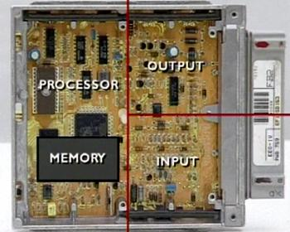
ECU Components
Analog-to-digital-converters
High-level digital outputs
Digital-to-analog converters
Signal conditioners
Communication chips

Slide 45
Questions?

Slide 46
References
Government Google Subpoena
http://www.npr.org/templates/story/story.php?storyId=5165854
http://www.nytimes.com/2006/01/20/technology/20google.html?_r=4&pagewanted=all
http://support.google.com/mail/bin/answer.py?hl=en&answer=7995
PETs
Bobby Vellanki, “Privacy Enhancing Technologies (PET),” CS457, Computer Science Dept., Yale University, Oct . 2003.
http://www.cs.cmu.edu/afs/cs/Web/People/yangwan1/papers/2008-Handbook-LiabSec-AuthorCopy.pdf
http://www.cbpweb.nl/downloads_technologie/pisa_handboek.pdf
Privacy Legislation
http://www.networkworld.com/news/2012/012612-privacy-scandals-255357.html?page=3
http://www.it.ojp.gov/default.aspx?area=privacy&page=1279
http://en.wikipedia.org/wiki/Electronic_Communications_Privacy_Act
http://en.wikipedia.org/wiki/Internet_privacy
Public webcmas:
http://thelongestlistofthelongeststuffatthelongestdomainnameatlonglast.com/first91.html
http://www.ehow.com/about_4613323_webcams.html
http://video.planetgreen.discovery.com/work-connect/scientists-webcams-climate-change.html
http://dataprivacylab.org/courses/dp1/fair/project16/paper.pdf
http://www.aviationpros.com/news/10437355/fbi-terrorists-monitoring-public-webcams
http://www.theatlantic.com/technology/archive/2012/09/turning-street-view-into-street-art/263019/
http://www.nytimes.com/2001/05/03/technology/webcam-s-scenic-view-raises-a-privacy-issue.html?pagewanted=all&src=pm

Slide 47
References continued
Computers in your Car
http://auto.howstuffworks.com/under-the-hood/trends-innovations/question113.htm
http://auto.howstuffworks.com/under-the-hood/trends-innovations/car-computer1.htm

